Slide 1
SAROPS Kick-Off Meeting
Search and Rescue Optimal Planning System (SAROPS)
Kick-Off Meeting
Northrop Grumman Information Technology
Defense Mission Systems
November 8, 2026

Slide 2
4 Search Planning Simulator
4.1 Local Data Base for Storing and Retrieving Data
  When a case is run from a district workstation
    GUI will interactively determine data required for planning through a series of queries.
    SAROPS will query Global Environmental and Search Planning Data bases at Martinsburg to retrieve data
    These data will be stored locally
      As future runs and plans are made on this case, the data is accessed automatically
      Data includes
        Environmental data necessary for case
        Lateral range functions for sensors
        Leeway of search objects
        Endurance for for SRUs, etc

Slide 3
4.1 Local Data Base
    As time progresses, user will be prompted to update environmentals
    As new sensors, SRUs, or objects are used, SAROPS will query Martinsburg for data on these items

Slide 4
4.2 Particle Filter
4.2 Monte Carlo (particle filter) event driven simulation
  In a particle filter, the continuous time and state stochastic process that represents the object’s probabilistic motion through state space is approximated by a finite number of sample paths (particles) drawn at random from the distribution of the stochastic process.
      Typically, paths are generated recursively
      Each path describes a possible motion of the object through state space
    State Space
      Position and velocity (kinematic components)
      Object type (ship, life boat, life raft, PIW)
      State (in distress, adrift, landed, alive or dead)
      Lifetime

Slide 5
4.2 Particle Filter
    Particle history can include pre distress movements
  Each particle is produced using Monte Carlo Simulation with probabilistic distributions determined by user input and data from the Global Environmental and Search Planning Data base
    Example:
      Initial position and time of a distress can be drawn from user specified initial position uncertainty and and distress time uncertainty
      Movement of particle determined drift vectors drawn from the distribution of winds and currents at the location of the particle. (use environmental data bases plus leeway info)
  Computation time roughly proportional to number of particles. Will have default with user adjustment

Slide 6

4.2 Particle Filter
  Each particle assigned a weight (pfail probability) = likelihood that particle represents object’s path
  Initially all weights are equal
    As search is applied, particle weights are modified for search effort
    As time progress some particles may end up with very low weights and others with much higher ones. In this case, we will resample to produce a new set of paths with equal weights.
    Particle filtering is a method of implementing discrete, non-linear, Bayesian Tracking
    Particle filter will be implemented in Java

Slide 7
4.3 Scenario Analysis/Generation
4.3 Scenario Analysis/Generation (Maritime)
  Build 1 of SAROPS will address only maritime scenario generation
  The system will be designed to produce any of the scenarios described below and combine them with a pre-distress scenario
    Example: Fishing boat leaves port, goes to a number of fishing grounds where it will spend time fishing and returns to port.

Slide 8
Missing F/V Scenario Type
Fishing Area A
Probable Error of Turn Point Position
Home Port
Fishing Area B

Slide 9
4.3 Scenario Analysis/Generation
Scenarios for build 1
  Voyage scenario where object can pass through or loiter in a number of positons
  Initial position (with bivariate normal uncertainty) and time uncertainty for an event plus an offset for initial location and time of distress
  Positions obtained from SARSAT/DASS
  Postion distributions deduced from LOBs from observations (measurements) from DF, Flares, Loran, and others
  Areas defined by polygons
  Combinations of great circle and rhumb line routes with uncertainties
  Reverse drift scenarios

Slide 10
4.4 Object Attributes/States/Weights
  Each particle will have a complete history of its path through state space to present time. Info will include
      position, velocity, object type, scenario, state, weight, lifetime and other info necessary to determine its path such as leeway, alive or dead, aground, etc.
  Each scenario will be given a weight by the user
      Weight on particle will be pfail since last resample
      For each scenario we store cum prob of failure before last resample
  In addition to usual posterior distribution on location and prob of success SAROPS will compute
      Posterior distribution of each object type
      Posterior position distribution for each scenario
      Cum prob of success for each object type
      Distribution of Point aground

Slide 11
4.4 Object Attributes/States/Weights
  Re-weight scenarios without re-running simulation
  New scenarios can be added mid incident without rerunning the whole simulation
Trajectory Data
  Full trajectory data kept for each particle
    This facilitates time updates for time late info
Last Analysis Time
  Last analysis time will be stored on each particle so that updated environmental information can incorporated. (Simulation is rolled back to time of last analysis and run forward)

Slide 12
4.5 State Changes
State Changes
  State changes will be determined probabilistically and become part of the particle trajectory history, e.g.,
      non-distress to distress
      alive to expired
      underway to adrift
      adrift to grounded
      one type to another, e.g., small boat to PIW
  Motion, detection, and survival characteristics depend on state and will therefore change over time
  By using data from the Global Environmental Data Base and the Search Planning Data Base stored locally, SAROPS will apply the correct drift, leeway, and detection characteristics to motion and search updates

Slide 13
4.6 Motion Modeling
4.6 Motion Modeling
    For each particle at each time, SAROPS will make a draw from the ocean current and surface wind distribution for that time and place.
    determine leeway and ocean drift vector
    the sum of these two will be total drift vector
    Correlation time model will be used to determine when to obtain new draws for wind an ocean currents
    Time between draws will depend on whether particle is in open ocean or near shore (SAROPS will have a local land data base.)
    If a particle hits land it can be stuck there or slide along the shore

Slide 14
4.7 Search Evaluation
4.7 Search Evaluation
  Searches will be evaluated using the planned (or actual) track of the SRU vs time.
      Planned tracks can be obtained from standard search pattern, trackline search, or from coverage factor
      Evaluations will be done using lateral range functions to represent the search sensors detection capabilities
      If a sweep width is available but not a lateral range function, SAROPS will estimate a lateral range function
  Basic Approach
      Advance SRU a small distance along its search path
      Any particle within max detection range will have it weight multiplied by 1 - P_{d}(r) where r is the lateral range of particle to sensor
      Details more complex - e.g. want to do this at CPA of particle to sensor
      Multiple sensors can be properly handled

Slide 15
4.8 Near Optimal Search Plans
4.8 Near Optimal Search Plan Recommendations
  For build 1:
    Myopic plans for mulitple SRU/ single rectangle areas
      Approach is to improve single rectangle optimization in present system to account for multiple target types
      For Multiple SRUs optimization will recommend sub rectangles within the single rectangle where each SRU will search
      Optimization will be based on appropriate POD vs effort function, e.g., inverse cube, exponential
      Optimization will account for previous unsuccessful search effort
  Full multiple SRU/ multiple rectangle optimization planned for build 2

Slide 16
Backup Slides

Slide 17
References
  [1] Sequential Monte Carlo Methods in Practice by Doucet, A., de Freitas, N, and Gordon, N. (2001) Springer, New York.
  [2] Technical Description of Nodestar TMA, Metron report to DARPA by L. D. Stone and S. L. Anderson, dated 4 April 2003.
  [3] “Search for the SS Central America: Mathematical Treasure Hunting,” by Lawrence D. Stone, Interfaces 22 1 January – February 1992, pp. 32 -54.
  [4] “Optimal Survivor Search with Multiple States” by J. H. Discenza and L. D. Stone, Operations Research 29 309 – 323 (1981).

Slide 18
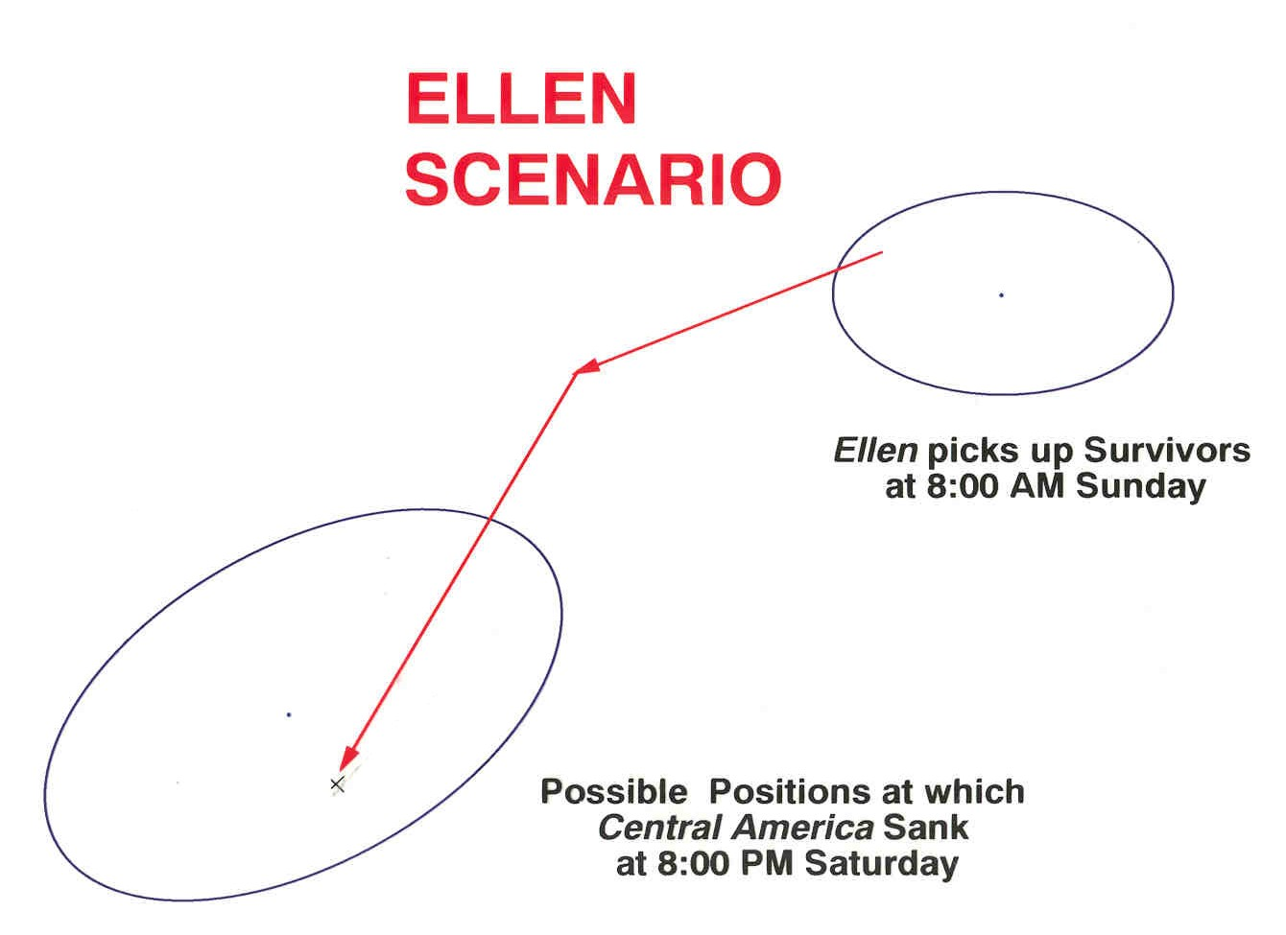

Slide 19
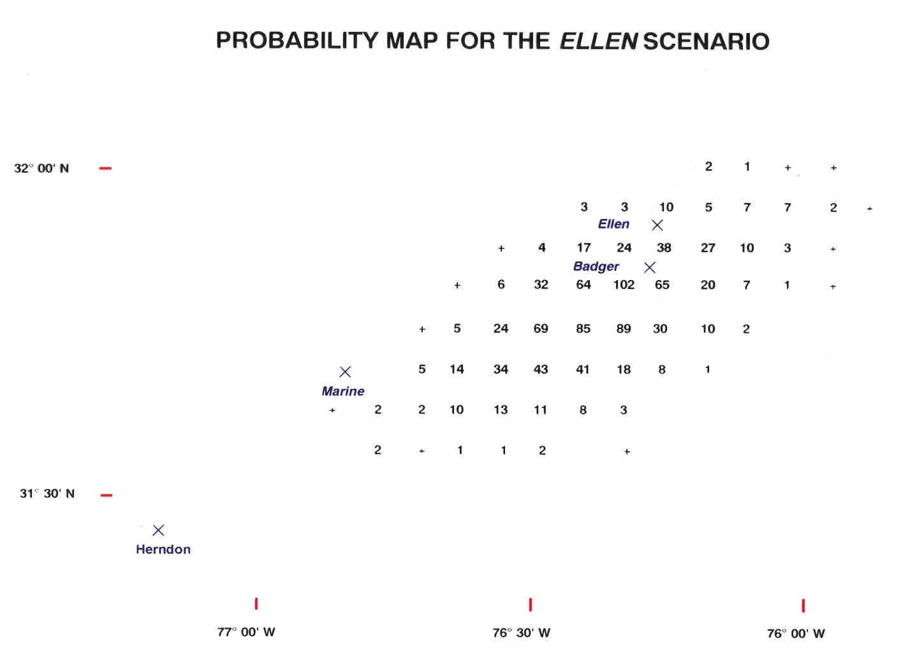

Slide 20
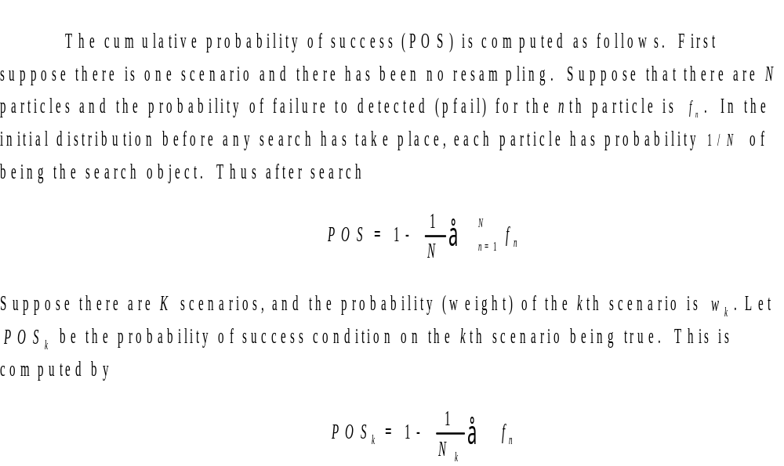
Probability of Success Calculations

Slide 21
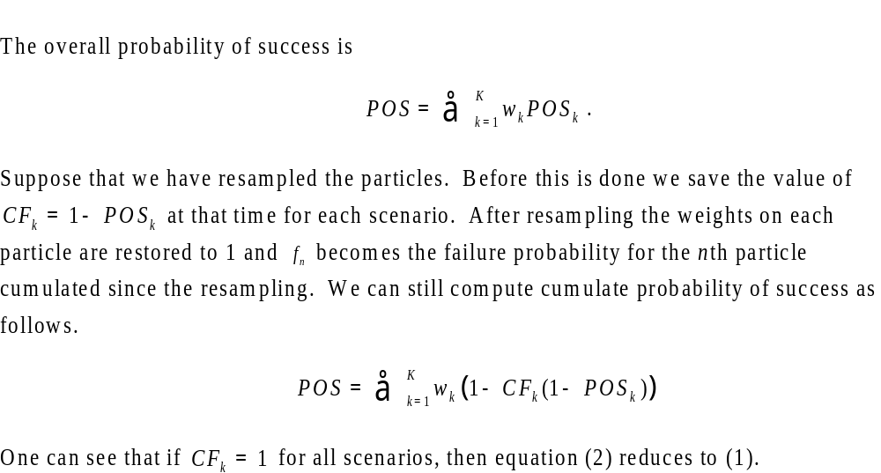
Probability of Success Calculations

Slide 22
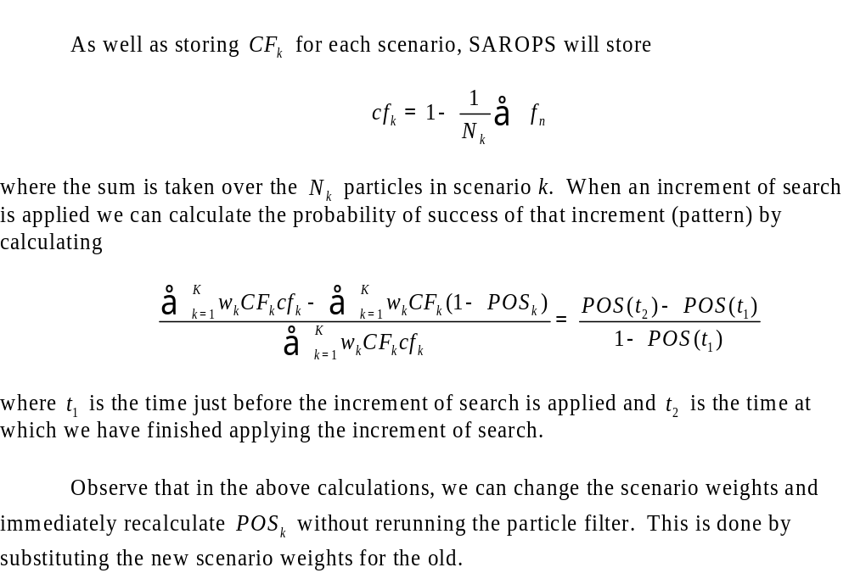
Probability of Success Calculations

